Slide 1
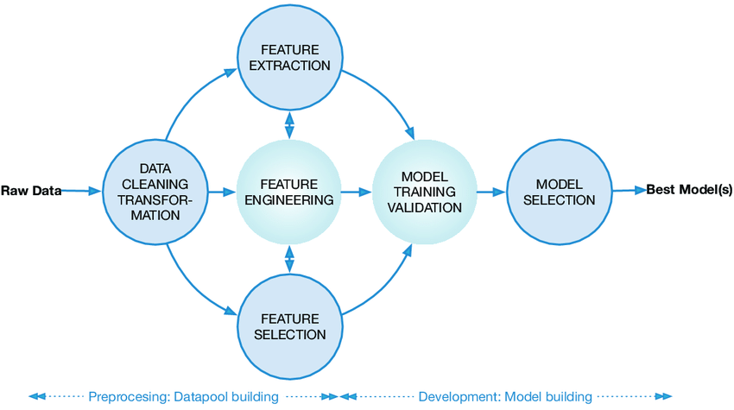
Machine Learning in Finance
Uses historical data.
Plays a pivotal role in reshaping how financial institutions operate.
1982, Apex created PlanPower.
Article-Abhishek Gupta AI Ethics Researcher at District 3 and McGill University
The History of AI in Finance. This article has been co-written with… | by Sydney Swaine-Simon | District 3 | Medium
Types of Financial Data
Market Data
Fundamental Data
Alternative Data
Transaction Data

Slide 2

Machine Learning Models in Finance
Unsupervised Learning
Classification Models
Regression Models
Model Evaluation and Validation
Cross-validation techniques
Performance metrics
Overfitting and underfitting
Backtesting for trading strategies
Applications of ML in Finance
Fraud Detection
Credit Scoring
Algorithmic Trading
Portfolio Management
Customer Service
Risk Assessment
Risk Assessment

Slide 3
Data Collection and Preprocessing
Risk Identification
Risk Measurement
Model Training
Backtesting
And
Validation
Compliance
and
Reporting
Continuous Improvement
Benefits:
Improved Accuracy
Cost Reduction
Risk Management
Customer Experience
Competitive Advantage
Challenges
Data Quality
Interpretability
Low signal-to-noise ratio
Model Robustness

